Slide 2



Slide 3
Components of food. Topic – Carbohydrates.
By - MOHIT HAJELA

Slide 4

What Are Carbohydrates?
Carbohydrates are one of the main types of nutrients that our bodies use for energy.
They are made up of carbon, hydrogen, and oxygen atoms, and they are found in a wide variety of foods.
Carbohydrates are important because they provide the primary source of energy for our bodies, especially for our brain and muscles.

Slide 5

Carbohydrates are nutrients found in foods like bread, fruits, and vegetables that provide the body with energy, especially for the brain and muscles.

Slide 6
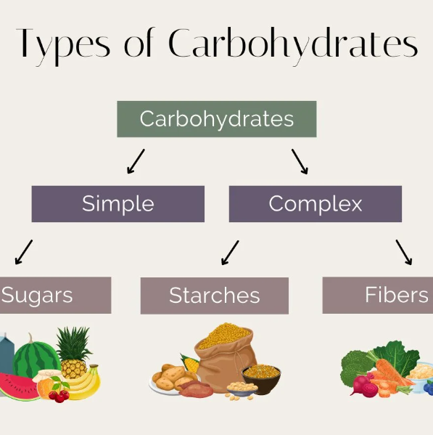
Types of carbohydrate
Simple
Complex

Slide 7
simple carbohydrate

Slide 8

Simple carbohydrate (sugar)
Simple carbohydrates, also known as simple sugars, are made up of one or two sugar molecules. They are quickly digested and absorbed by the body, providing a rapid source of energy. Simple carbohydrates are found naturally in some foods and are also added to many processed foods.

Slide 9
complex carbohydrates

Slide 10

complex carbohydrate (sugar)
Complex carbohydrates are made up of long chains of sugar molecules, which means they take longer for the body to break down and digest compared to simple carbohydrates. This slower digestion process provides a more gradual and sustained release of energy, making complex carbohydrates a more stable source of energy for the body.

Slide 11

Disadvantage of Carbohydrate
Weight Gain: Eating too many carbs can lead to weight gain because extra carbs are stored as fat.
Blood Sugar Spikes: Foods with lots of sugar can cause quick rises in blood sugar, which can be bad for your health.
Dental Problems: Sugary foods can lead to tooth decay and cavities.
Nutrient Gaps: Eating too many refined carbs can mean missing out on important nutrients like vitamins and minerals.
Stomach Issues: Too much fiber can cause bloating or gas if you suddenly eat a lot of it.

Slide 12

Advantages of Carbohydrate
Energy: They provide a primary source of energy for the body and brain, helping you stay active and focused.
Digestive Health: Foods high in fiber, a type of carbohydrate, aid in digestion and help prevent constipation.
Stable Blood Sugar: Complex carbohydrates release energy slowly, helping to maintain steady blood sugar levels.
Nutrient-Rich: Many carbohydrate-rich foods, like fruits, vegetables, and whole grains, are also packed with vitamins, minerals, and antioxidants.
Satiation: High-fiber foods help you feel full longer, which can help with appetite control and weight management.

Slide 13
Learned
What are carbohydrates
Types of carbohydrates
Simple carbohydrates
Complex carbohydrates
Disadvantages of carbohydrate
Advantages of carbohydrates

Slide 14
Summary
Carbohydrates: Provide energy for the body.
Simple Carbohydrates: Quick energy sources, found in fruits and sweets.
Complex Carbohydrates: Include starches and fiber, providing sustained energy and aiding digestion.

Slide 15
1. Which type of carbohydrate provides quick energy?
A) Complex carbohydrates
B) Simple carbohydrates
C) Fiber
D) Protein
(correct)

Slide 16
2. What is the main purpose of carbohydrates in the body?
To build muscle
To provide energy
To store fat
To maintain temperature
(correct)

Slide 17
Any Questions ?

Slide 18
Thank you!!

Slide 19

PPT produced by MOHIT HAJELA
From Class 6th Argonite
Thank you Lipi Kekha mam for giving me this chance.

